Slide 1
Dots and boxes
Adam Tucker
Calvin Chan

Slide 2
Game rules
Take turns adding lines to a grid of points
If a box is formed, the player that made the box gets a point and gets to go again
Game ends when no more lines can be added
Winner is the one with most points

Slide 3
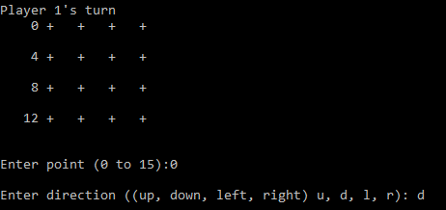
Turn 1

Slide 4
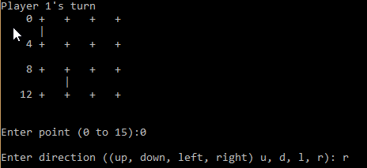
Turn 2

Slide 5
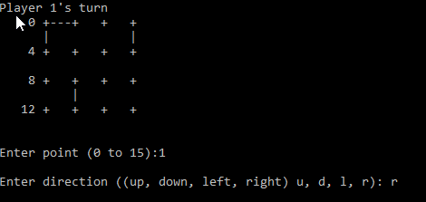
Turn 3

Slide 6
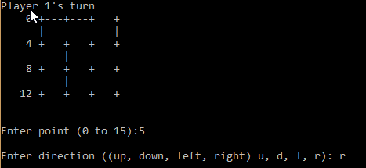
Turn 4

Slide 7
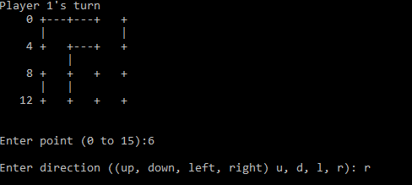
Turn 5

Slide 8
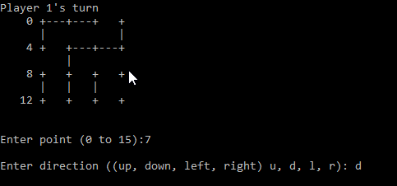
Turn 6

Slide 9
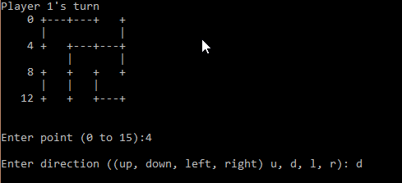
Turn 7

Slide 10
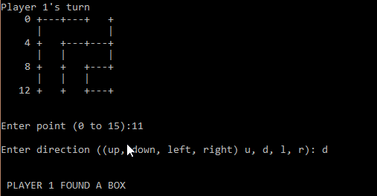
Turn 8

Slide 11
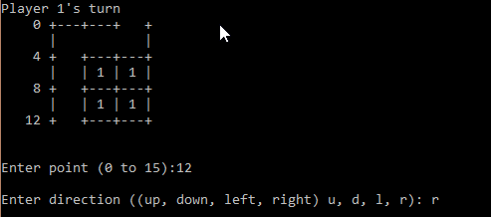
Turn 9

Slide 12
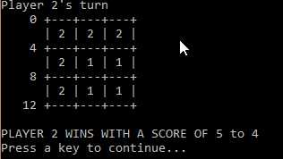
Turn 10

Slide 13
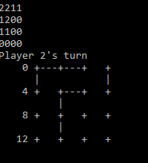
How the AI works
AI rates each potential edge as
Good: Will result in a point for the AI
OK: Will not result in a point for the player
Bad: Will result in a point for the player
Initial choices based on number of edges each box has
AI will choose Good edges first, then OK and finally will choose a bad edge

Slide 14
Choosing the best bad case
If there are no more Good or Ok edges left to make, the AI tries to pick the best bad case.
Does this by creating copy of current game board
Tests a bad case, sees how many points it gives away
Keeps testing until board is solved
Pick bad edge that gives away the least number of points

Slide 15
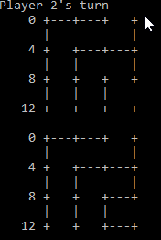
Decision making
AI has no option but to give away some points
Creates copy
Tests bad edge

Slide 16
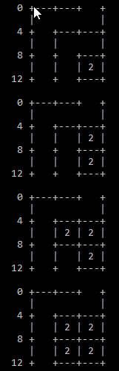
Decision Making
Sees how many points it gives up

Slide 17
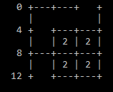
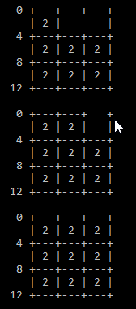
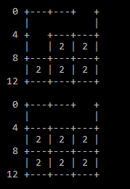
Decision Making
Repeats for new bad edge

Slide 18
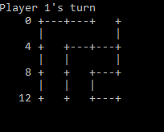
Decision making
Ended up choosing the bad edge that gave the fewest number of points to other player (4 vs 5)

Slide 19
AI wins
Due to choosing the better option, the AI won

